Slide 1
YelpViz
Nijiati Abulizi,
Kulaphong Jitareerat,
Craig Adlam
GitHub : https://github.com/kulaphongj/yelp_api_wrapper.git

Slide 2
Project Focus
Engaging visualization of business-related information

Slide 3

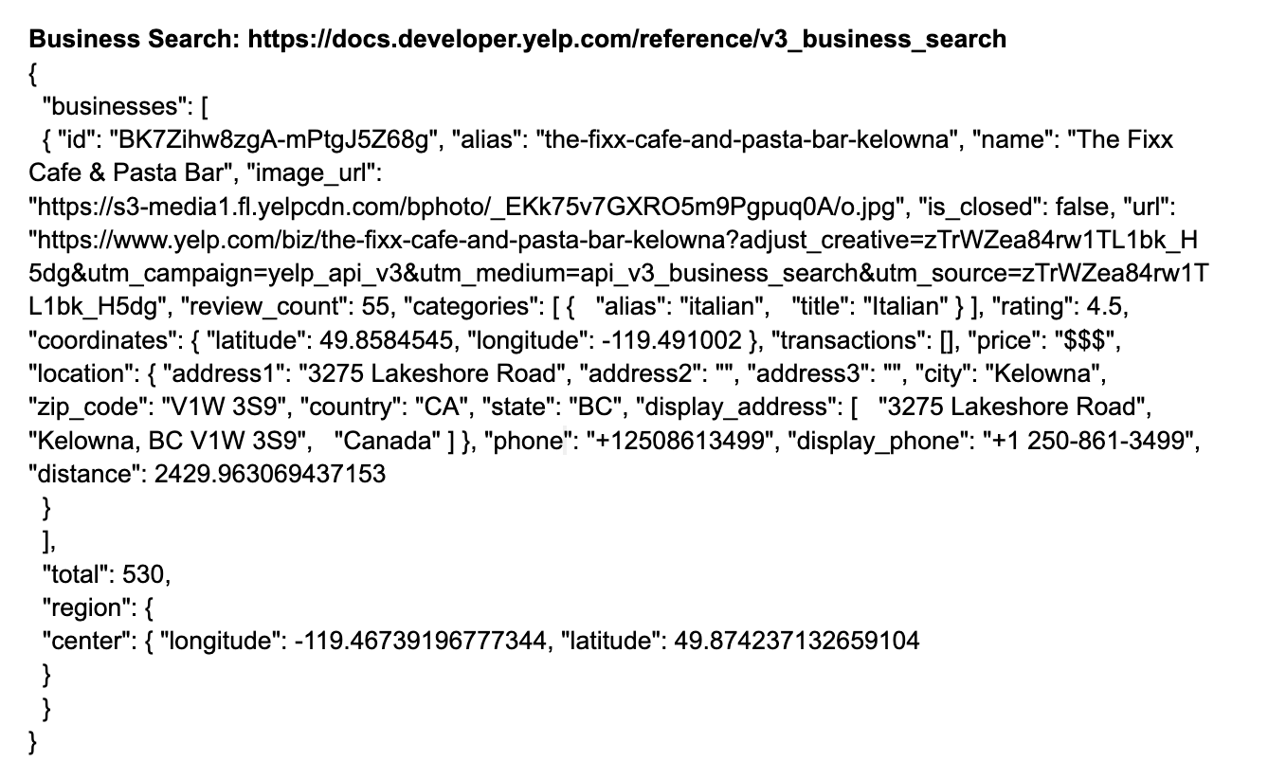
Yelp API Description and Sample
Key Features of API:
Business Search: Filter by type and location.
Reviews: Access ratings and reviews.
Business Details: Get comprehensive business information, photos, and transactions.
Sample API Data:

Slide 4
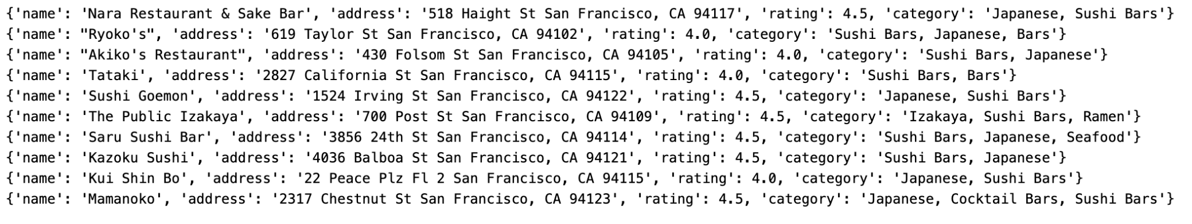
Function 1: Search Businesses
Purpose: Simplify Yelp business searches and data gathering.
1. search_businesses:(up to 50 entries)
Purpose: Targeted Yelp search
Params: api_key, location, business_type, keyword, offset, limit
Function: Fetches Yelp business listings
2. get_all_businesses: (necessary to get more than 50 data)
Purpose: Aggregates detailed business data
Params : Inherits search_businesses params, adds total
Function: Collects specified number of results
Sample Output:

Slide 5
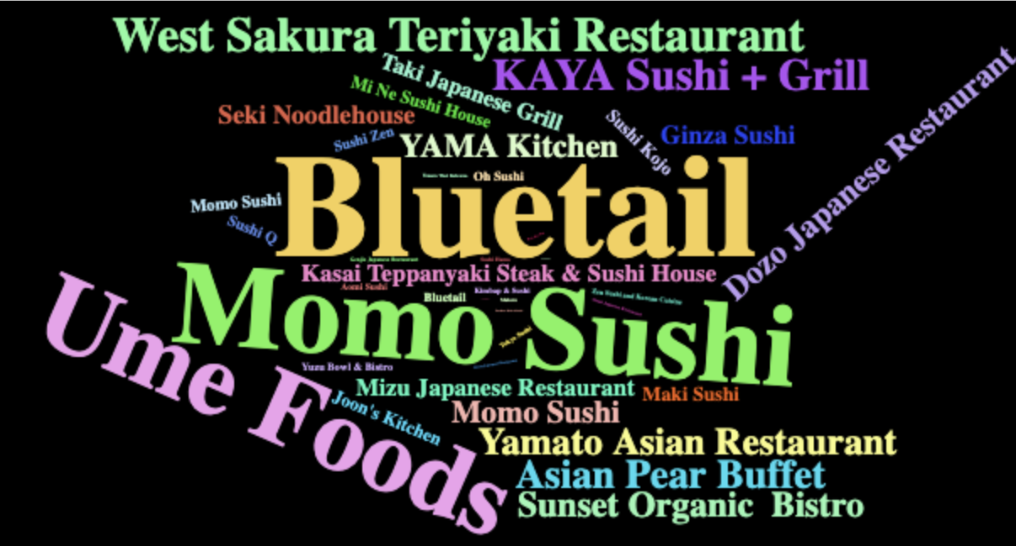
Function 2: Create Word Cloud
Purpose:
Generates a word cloud from Yelp business data, weighted by ratings and review counts.
Params:
‘data’ - Business data from Yelp search results.
Function:
- Maps business names to weighted ratings.
- Creates a word cloud visualization.
- Displays word cloud.
Sample Output:
sushi <- get_all_businesses(api_key = api_key, 'kelowna','restaurants','sushi')
create_word_cloud(sushi)

Slide 6
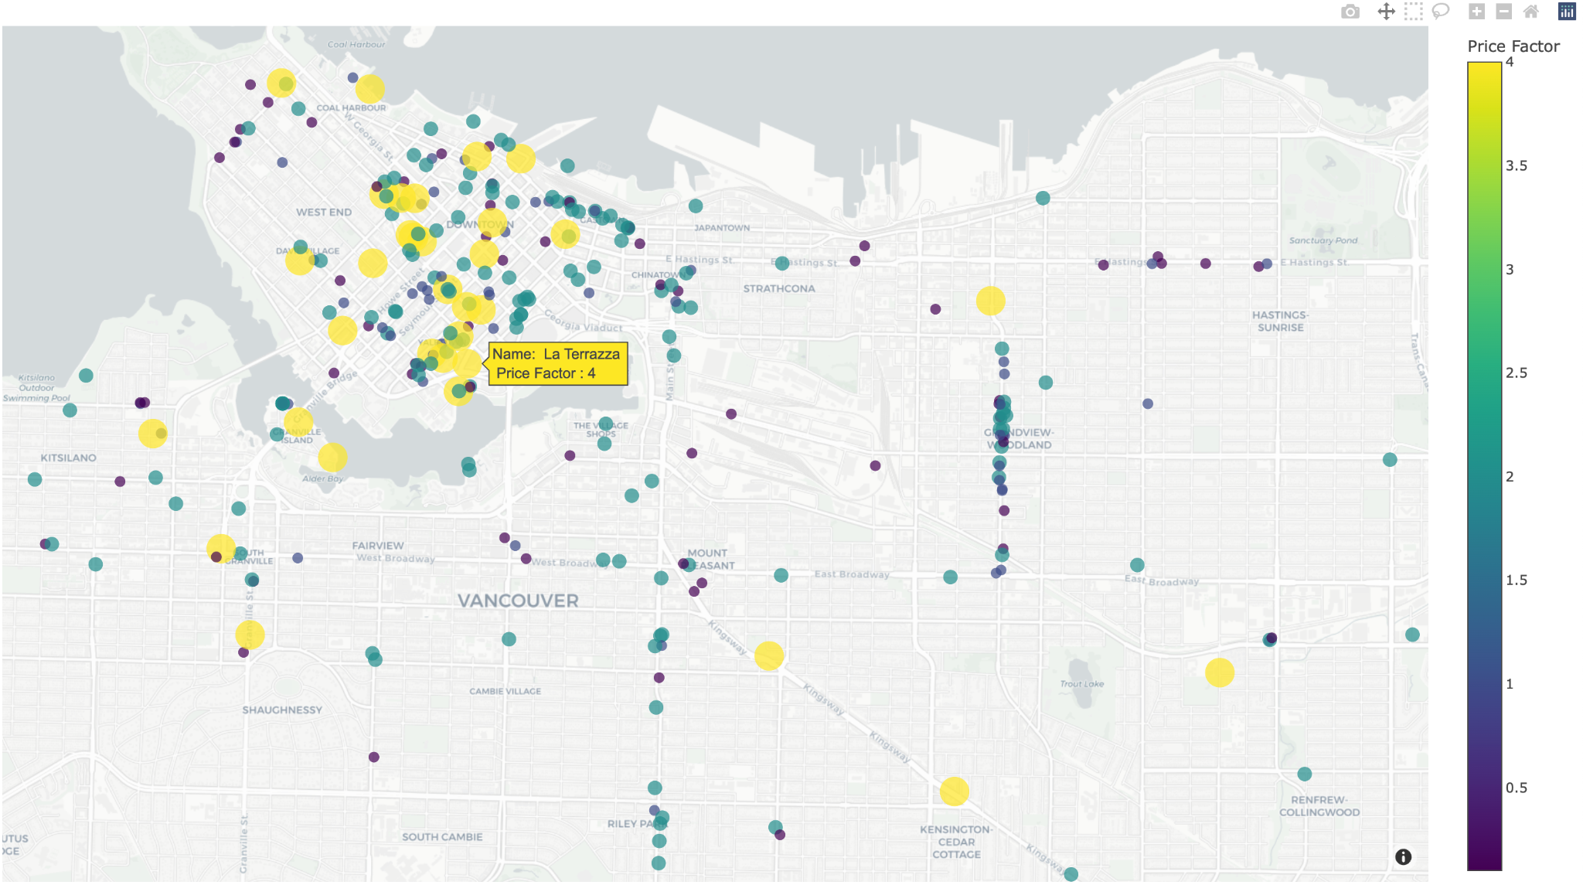
Function 3: Create Geo Heatmap
Purpose: Visualize the price/rating/reviews heatmap on a map.
Params:
data: Business data from Yelp search results.
value: ('price_level', 'rating', 'count reviews', 'weighted rating')
Function:
Plot the heatmap of price level, rating, number of review, weighted rating on a map.
Sample Output:
fig <- create_geo_heatmap(df_business, factor_plot="price_factor")
fig

Slide 7
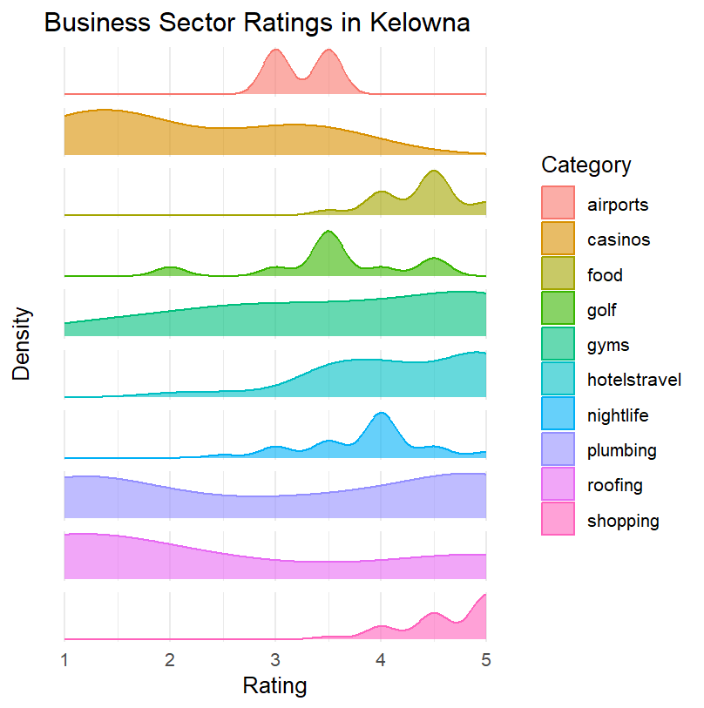
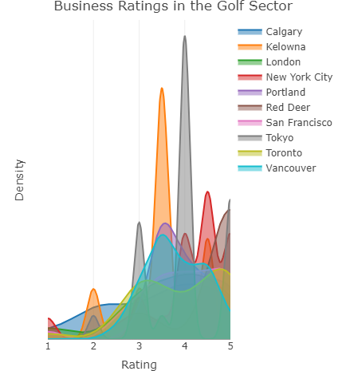
Function 4: Analyze Rating Review
Purpose: simplify business analytics/visualization
1. analyze_cities
Purpose: retrieves business ratings across multiple cities Params: api_key, location, categories, limit
Function: aggregated ratings for location(s) visualized
2. analyze_business_sectors
Purpose: retrieves business sector ratings within one city Params: api_key, location, categories, limit
Function: aggregated ratings for business(es) visualized
Sample Output:
location <- c('Kelowna', 'Seattle', 'London', 'Tokyo', 'Calgary', 'Vancouver', 'Toronto', 'Portland', 'New York City', 'San Francisco')
result_cities <- analyze_cities(api_key, location, 'golf', 33)

Slide 8
Behind the Scene
Unit testing
Documentation (Roxygen2)
Vignette creation (Vignette)
Publishing the package via GitHub

Slide 9
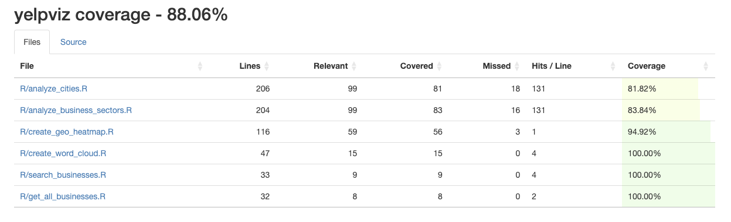
Code Coverage

Slide 10
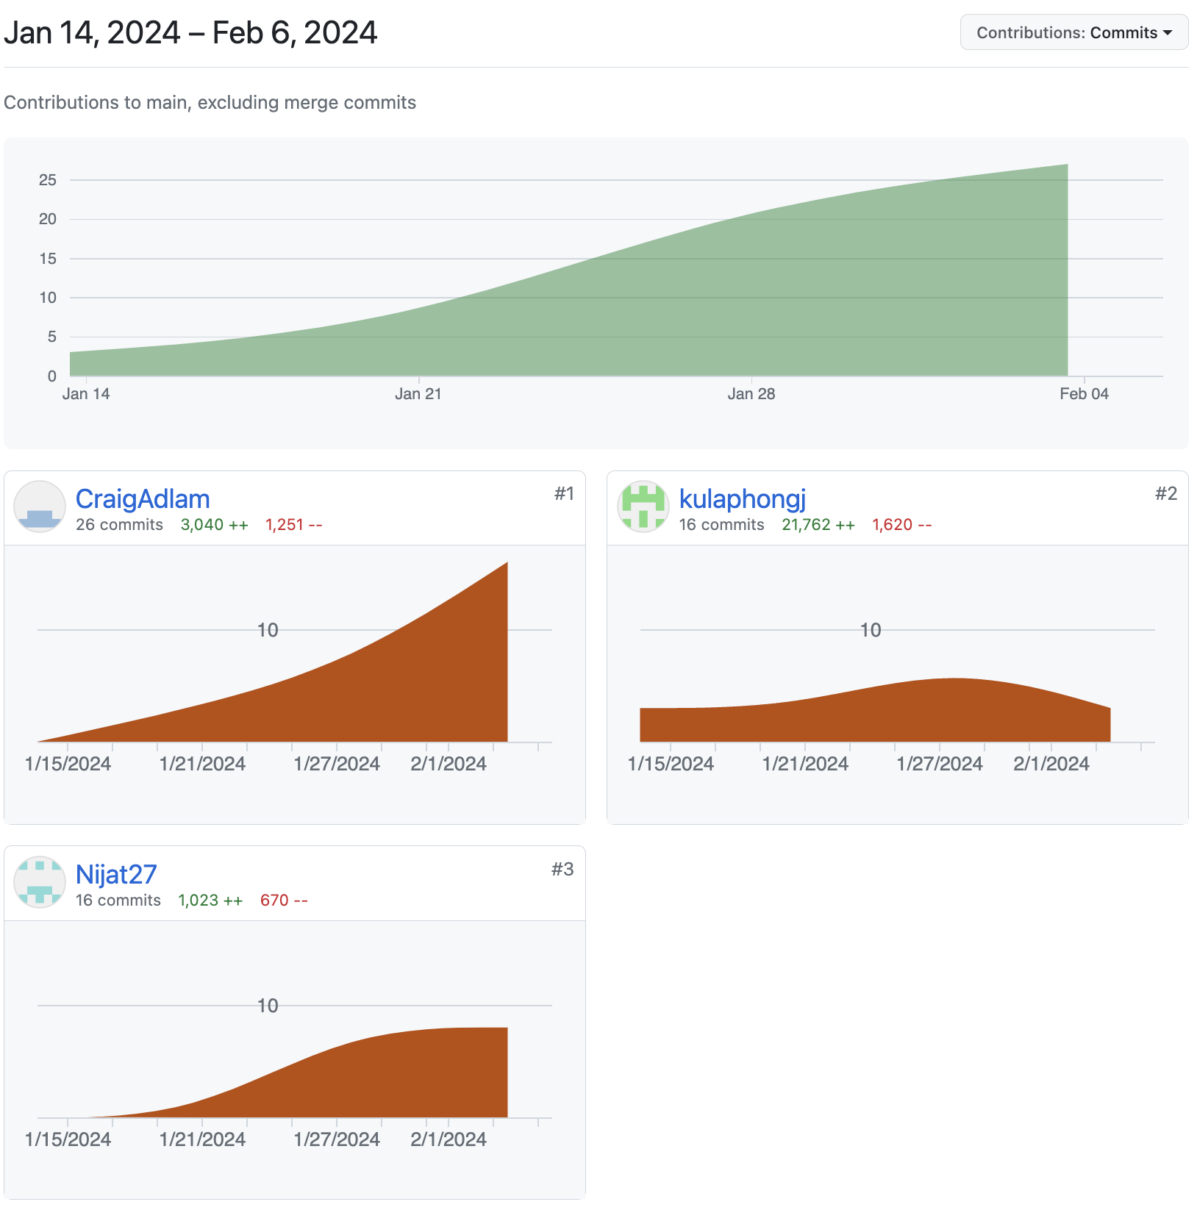
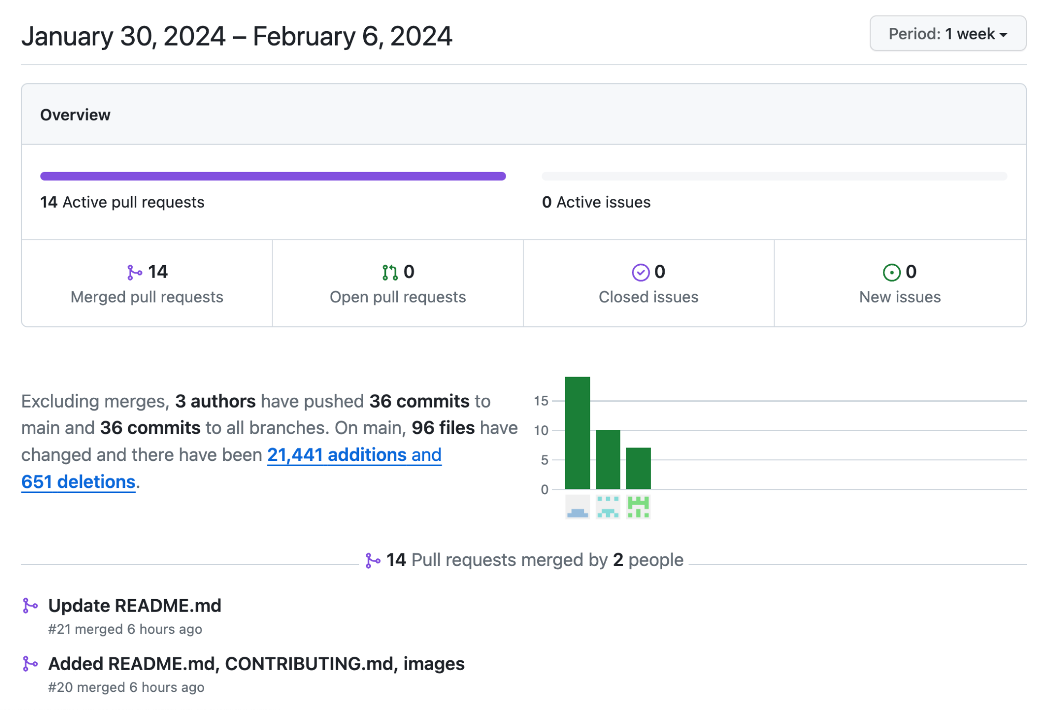
Contribution
Nijiati Abulizi: create_word_cloud, get_all_businesses, search_businesses; presentation material
Kulaphong Jitareerat: create_geo_heatmap; GitHub Action, R package build
Craig Adlam: analyze_cities, analyze_business_sectors; README

Slide 11
Demonstration Time!

Slide 12
Thank You

